Slide 1
Paper Review
Responding to News Sensitively in Stock Attention Networks via Prompt-Adaptive Trimodal Model
Haotian Liu, Bowen Hu , Yadong Zhou and Yuxun Zhou
IEEE TRANSACTIONS ON NEURAL NETWORKS AND LEARNING SYSTEMS, VOL 36, NO. 6, JUNE 2025

Slide 2
Outline
Introduction
Related Work
Problem Statement
PA_TMM Architecture
Model Optimization
Experiments
Conclusion

Slide 3
Introduction
Backgrounds and Challenges
New Challenge of Stock Movement Prediction
Limitations of Existing Models
Feature Imbalance
in Real Markets
Rapid growth of multimedia platforms
Financial news & social media provide crucial investment signals
Stock prices contain randomness (random walk)
But, there is deterministic components driven by news
Time-series forecasting Model - Two feature modalities: Time-series features, Discrete Technical indicators - Ignore inter-stock dynamics like Momentum spillover
GNN Model - Hard-coded microstructure → Capture limited interactions
GATs Model - Dynamically assign weights → Massive price-related features → Biased attention effect
A fraction of stocks have the news
Long-tailed Distribution - Breaking news receive insufficient attention - Distracted by abundant time-series data
Two Challenges - Biased attention toward the dominated head features - Data scarcity problem → Poor generalization
Notes:
- multivariate time-series features
- opening price, closing price, and volume
- discrete tabular features
- technical indicators calculated based on historical trading signals
- 가격·거래량 등 시계열 데이터를 기반으로 일정한 계산식(공식)을 적용하여 도출된 숫자형 요약 지표들
- MA (이동평균선): 일정 기간 동안의 평균 가격. 상승/하락 추세 식별
- MACD: 장·단기 이동 평균선 간 차이를 통해 추세 전환 포착
- 왜 "이산형(discrete)"일까?
- 하루 단위, 혹은 특정 윈도우(5일, 14일, 30일 등)를 기준으로 하나의 고정된 수치 값을 출력
- 연속적인 시계열이 아닌, 고정된 시점에서의 하나의 값으로써 **이산적(discrete)
모든 주식은 서로 독립적이라는 가정하에 서로 간의 상호작용을 무시(Assume all stocks are mutually exclusive)
- Why? momentum spillover effect(모멘텀 전이 효과)
- factor movement:주식 수익률에 영향을 주는 공통 요인(Market factor, Value, Growth, Small/Big, Momentum)이 변하면서 개별 주식 또는 여러 섹터에 영향을 미침
- lead-lag effect: 한 자산(또는 지표)의 가격 움직임이 시간적으로 선행(lead)하고, 다른 자산이 뒤따라서 반응(lag)하는 현상
- t: 기술주 ETF 급등 ➡️ t+1: 삼성전자 상승
- portfolio rebalancing: ETF나 기관 포트폴리오의 리밸런싱 ➡️ 포함된 여러 종목에 동시적으로 매수 또는 매도 압력
- 현실에서는 주식 간 다음과 같은 상관관계(correlation) 또는 **영향 전이(spillover)**가 존재
- 삼성전자 주가 상승 → SK하이닉스 주가도 반응
- 테슬라 실적 발표 → LG에너지솔루션 영향

Slide 4
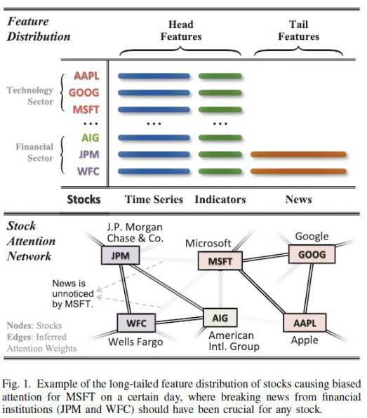
Introduction
Backgrounds and Challenges
(top)
All stocks: Time-series features and Technical indicators → Head Features
Few stocks: News → Tail Features
(bottom)
JPM, WFC: Breaking news that impact the overall stock market
Other sectors: Baised attention

Slide 5
Introduction
Solution
Core Idea
Key Components
Data Augmentation Strategy
Capture both news-induced movements and peer interactions through a graph-based, attention-driven framework
Trimodal inputs: price, indicators, and news
Prompt = summary vector of other stocks’ sentiments
Two main modules:
Cross-modal fusion: extract news-induced prompts
Graph dual-attention: dynamically infer stock relationships
Equivalence Resampling (EQSamp):
Generates putative news from stock price movements
Addresses news scarcity during pretraining
Movement Prompt Adaptation (MPA):
Pretrain on synthetic prompts
Enhances generalization under long-tail feature imbalance

